Slide 1
R PROGRAMMING Retail Sales Prediction
B.SHRADDHA
(BI-III-B)
221FA14117

Slide 2
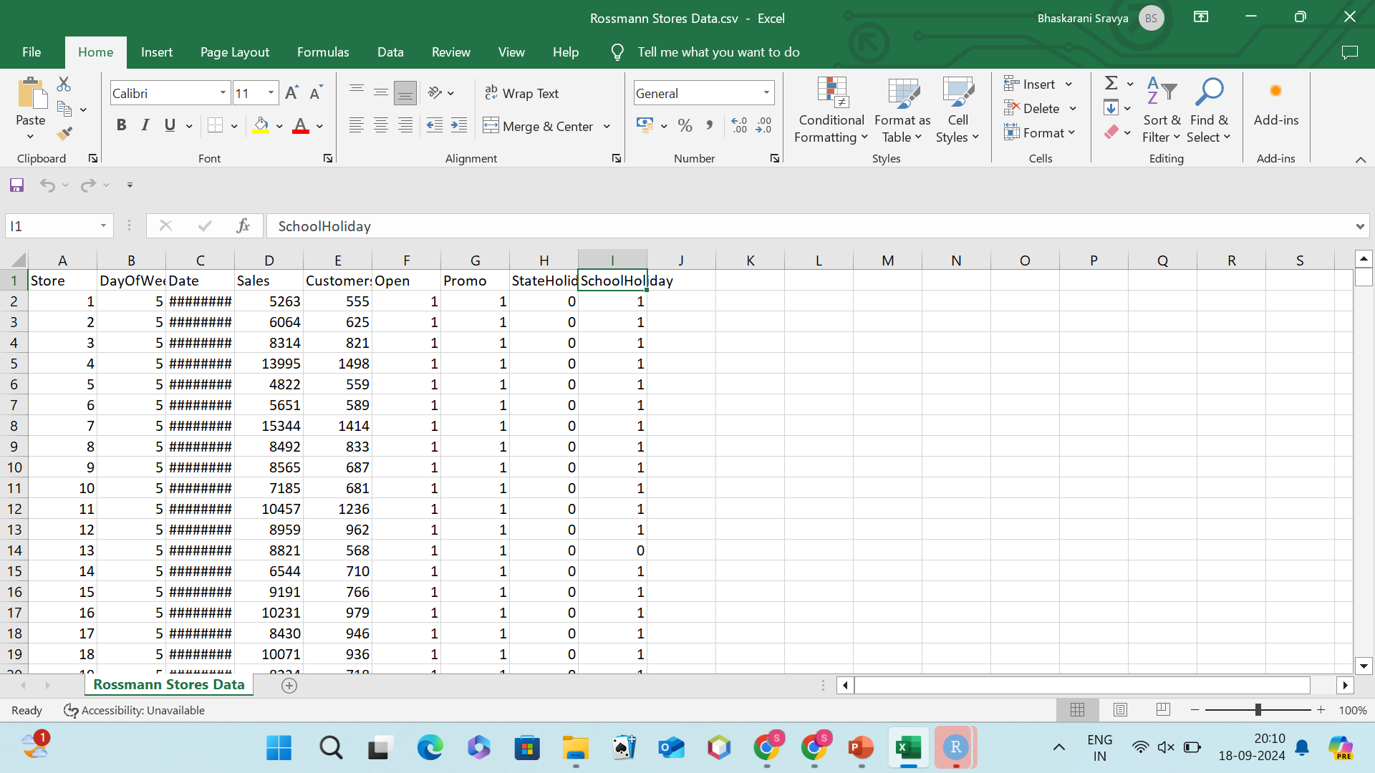

Slide 3
01
Industry Overview.
You can enter a subtitle here if you need it

Slide 4
Industry Overview.
In the retail sector, particularly for large chains like Rossmann, accurate sales forecasting is crucial for optimizing operations. Retailers use forecasting to manage inventory, staffing, and promotional strategies, ensuring they meet customer demand without overstocking or understaffing.
Key factors influencing sales include:
Seasonality: Sales fluctuate during holidays and special events.
Promotions: Discounts and campaigns drive customer traffic.
External Factors: Holidays and school breaks impact customer behavior.
Leveraging predictive analytics based on historical sales data allows retailers like Rossmann to make informed decisions, reduce costs, and improve customer satisfaction while remaining competitive in the market.

Slide 5
Business Problem Statement
CONTEXT:
Rossmann, a drugstore chain in Germany, has extensive sales data but struggles with accurate daily sales forecasts.
PROBLEM:
Inaccurate sales predictions lead to poor inventory management and staffing decisions, impacting profitability and customer satisfaction.
Objective: Develop a predictive model to forecast daily sales for each store, enabling optimized operations and better decision-making.
FOLLOW-UP ACTIONS
Data Preparation: Clean and preprocess the Rossmann dataset.
Exploratory Data Analysis (EDA):Analyze sales trends and identify key influencing factors.
Feature Engineering: Create relevant features from historical data and external influences.

Slide 6
Continuation
Feature Engineering: Create relevant features from historical data and external influences.
Model Development: Select and train appropriate predictive models (e.g., Random Forest, XGBoost).
Model Evaluation: Assess model accuracy using metrics like RMSE or MAE.
Implementation: Deploy the model for real-time sales predictions.
Impact Analysis: Evaluate the effect of forecasts on inventory and sales performance.

Slide 7
Describe dataset and Plan of Action
Rossmann Stores Data
This dataset appears to contain sales data for a chain of Rossmann stores. The columns are likely:
Store: Unique identifier for each store.
DayOfWeek: Day of the week (1-7).
Date: Date of the sale.
Sales: Total sales for the day.
Customer: Number of customers who visited the store.
Open: Indicates if the store was open (1) or closed (0).Promo: Indicates if a promotional campaign was active (1) or not (0).

Slide 8
StateHoliday: Indicates if a state holiday was observed (1) or not (0).
SchoolHoliday: Indicates if a school holiday was observed (1) or not (0).
GOAL
Based on the given information, it seems the primary goal is to analyze the factors influencing sales in Rossmann stores. This could involve:
Identifying the busiest days of the week.
Analyzing the impact of promotional campaigns.
Understanding the effects of holidays on sales.
Exploring the relationship between customer count and sales.
PLAN OF ACTION
Data Cleaning:
Check for missing values and handle them appropriately (e.g., imputation or deletion).Ensure data consistency (e.g., correct date format).Convert categorical variables (e.g., DayOfWeek, Open, Promo, StateHoliday, SchoolHoliday) to appropriate data types.

Slide 9
Exploratory Data Analysis (EDA)
Summarize the data (e.g., mean, median, mode, standard deviation) for numerical variables.
Explore the distribution of variables using histograms, box plots, and other visualizations.
Analyze the relationships between variables using correlation analysis and scatter plots.
Identify any outliers or anomalies.
Feature Engineering:
Create new features if necessary (e.g., month, season, day of the month).
Consider transforming features (e.g., log transformations for skewed distributions).
Model Building:
Choose appropriate regression models (e.g., linear regression, decision trees, random forests) based on the nature of the data and the goal.
Train the models on the cleaned and prepared data.
Evaluate the models using appropriate metrics (e.g., R-squared, mean squared error, mean absolute error).
Model Interpretation:
Analyze the importance of different features in predicting sales.
Interpret the model's coefficients or decision rules to understand the factors influencing sales.
VISUALIZATION:
Create visualizations to communicate the findings effectively (e.g., bar charts, line charts, scatter plots).

Slide 10
Proposed Charts for EDA
1. Sales Distribution: Chart Type: Histogram Purpose: To understand the overall distribution of sales. This will help identify outliers, skewness, and the general range of sales values.
2. Sales by Day of Week: Chart Type: Bar Chart Purpose: To compare sales performance across different days of the week. This will reveal patterns in customer behavior and

Slide 11
3. Sales by Month: Chart Type: Line Chart Purpose: To analyze seasonal trends in sales. This will help identify peak and off-peak periods.
4. Sales vs. Customer Count: Chart Type: Scatter Plot Purpose: To examine the relationship between the number of customers and total sales. This will help understand the efficiency of customer conversion.
5. Sales by Store Type (if available): Chart Type: Bar Chart Purpose: To compare sales performance across different store types (e.g., small, medium, large, urban, suburban). This will help identify factors influencing store performance.

Slide 12
DATA PREPROCESSING: A FOUNDATION FOR MACHINE LEARNING
Data preprocessing is a crucial step in the machine learning pipeline, ensuring that data is clean, consistent, and suitable for model training. It involves two primary tasks: data wrangling and feature engineering.
Data Wrangling
Data wrangling refers to the process of cleaning and transforming raw data into a format suitable for analysis. This often involves:
Handling Missing Values:
Imputation: Replacing missing values with estimated values (e.g., mean, median, mode, interpolation).
Deletion: Removing rows or columns with excessive missing values.
Dealing with Outliers:
Identification: Using statistical methods (e.g., z-score, IQR) or visualization techniques.
Correction: Correcting errors or removing outliers if they significantly impact the data distribution.

Slide 13
Data Normalization and Standardization:
Normalization: Scaling data to a specific range (e.g., 0-1).
Standardization: Centering data around the mean and scaling to unit variance.
Data Type Conversion:
Ensuring data is in the correct format (e.g., converting text to numerical values).
Data Cleaning:
Removing duplicates, correcting errors, and inconsistencies.

Slide 14
REASONS FOR DATA SPLITTING
1)Model Evaluation:
a. Training Set: Used to train the model, teaching it to recognize patterns and relationships in the data.
b. Testing Set: Used to assess the model's ability to generalize to unseen data. By evaluating the model's performance on the testing set, we can gauge its effectiveness.
2)Preventing Overfitting:
a. Overfitting: A phenomenon where a model becomes too complex and fits the training data too closely, leading to poor performance on new data.
b. Regularization: Data splitting helps mitigate overfitting by ensuring that the model is not overly tailored to the training data.

Slide 15
3.Hyperparameter Tuning:
Hyperparameters: Parameters that are set before training a model (e.g., learning rate, number of hidden layers).Grid Search or Random Search: These techniques involve trying different hyperparameter combinations and evaluating their performance on the validation set.
COMMON DATA SPLITTING METHODS
1.Random Splitting: The simplest method, where data is randomly divided into training and testing sets.
2.Stratified Splitting: Ensures that the distribution of classes or labels is maintained in both sets, especially useful for imbalanced datasets.
3.K-Fold Cross-Validation: The dataset is divided into k folds, and the model is trained and evaluated k times, each time using a different fold for testing. This helps to reduce the variance of the evaluation.

Slide 16

MODELS USED IN MACHINE LEARNING: The choice of model depends on the nature of the problem and the characteristics of the data. Here are some common models: 1.Linear Regression: Suitable for predicting continuous numerical values. 2.Logistic Regression: Used for binary classification problems. 3.Decision Trees: Can handle both classification and regression tasks, creating a tree-like structure to make decisions. 4.Random Forests: An ensemble of decision trees, often providing better performance and robustness. 5.Support Vector Machines (SVMs): Effective for classification and regression, especially with high-dimensional data. 7.Neural Networks: Powerful models capable of learning complex patterns, often used for deep learning tasks. 8.Naive Bayes: Simple yet effective for classification, assuming independence between features. 9.K-Nearest Neighbors (KNN): Classifies or regresses new data based on the majority class or average values of its nearest neighbors.

Slide 17
Significant Improvements from Hyperparameter Tuning 1.Increased Model Accuracy: Fine-tuning hyperparameters often leads to lower prediction errors (e.g., reduced RMSE/MAE), enhancing the model's accuracy in forecasting daily sales. 2.Improved Generalization: Proper tuning helps prevent overfitting, allowing the model to perform better on unseen data, which is crucial for reliable sales predictions. 3.Enhanced Feature Utilization: Adjusting parameters like learning rate and tree depth can optimize how well the model utilizes available features, capturing more relevant patterns in the data. 4.Faster Convergence: Optimized hyperparameters can speed up the training process, allowing for quicker iterations and more efficient resource use. 5.Robustness to Variability: A well-tuned model is often more robust against fluctuations in sales due to external factors (e.g., holidays, promotions), improving overall predictive performance. 6.Better Interpretability: Some tuning techniques can enhance feature importance metrics, aiding in understanding which factors most influence sales, which is valuable for strategic decision-making.

Slide 18
CONCLUSION AND INSIGHTS Through the analysis of the Rossmann sales dataset, several key insights emerged: 1)Sales Trends: Sales exhibit clear seasonal patterns, with noticeable spikes during holiday periods and promotional events. 2)Influential Features: Store type, size, and promotional activities significantly impact daily sales, highlighting the importance of targeted marketing strategies. 3)Impact of External Factors: Holidays and local events correlate with increased sales, suggesting that timing promotions around these factors can drive revenue.

Slide 19
BEST FIT EVALUATION METRICS To assess the effectiveness of the predictive model, the following evaluation metrics are recommended: 1)Root Mean Squared Error (RMSE): RMSE provides a clear measure of the average prediction error in the same units as sales, making it intuitive for business stakeholders. 2)Mean Absolute Error (MAE): MAE offers a straightforward interpretation of average absolute errors, which is helpful for understanding typical forecasting performance. 3)R-squared (R²): This metric indicates the proportion of variance explained by the model, helping gauge overall fit and explanatory power. 4)Mean Absolute Percentage Error (MAPE): MAPE allows for evaluation of model performance in percentage terms, which is useful for understanding relative error in various contexts.

Slide 20
Model Explainability and Its Business Impact 1)MODEL EXPLAINABILITY: Model explainability refers to the degree to which a model's predictions can be understood by humans. It involves interpreting how the model makes decisions, identifying the factors that influence predictions, and ensuring that the results are transparent and comprehensible. In the context of machine learning models, especially complex ones like ensemble methods or deep learning, explainability is crucial for stakeholders to trust and effectively utilize the model. 2)Key Aspects of Model Explainability: a)Feature Importance: Understanding which features most significantly impact predictions helps identify critical drivers of sales. b)Decision Rules: Providing insights into how the model arrives at specific predictions (e.g., thresholds or logical rules) aids in demystifying the process. c)Visualization Tools: Using tools like SHAP (SHapley Additive exPlanations) or LIME (Local Interpretable Model-agnostic Explanations) can make complex models more interpretable through visual representations.

Slide 21
Business Impact of Model Explainability Enhanced Decision-Making: By understanding how predictions are generated, managers can make informed decisions regarding inventory, staffing, and promotional strategies. This leads to more effective business operations. Increased Trust and Adoption: When stakeholders can comprehend the model's workings, they are more likely to trust its predictions and integrate the insights into their workflows. Regulatory Compliance: In industries where accountability is essential, explainability helps meet regulatory requirements by providing justification for decisions based on model outputs. Improved Model Performance: Insights gained from explainability can lead to better feature selection and engineering, ultimately improving model accuracy and robustness. Risk Mitigation: Understanding model predictions helps identify potential biases or errors, allowing for adjustments before deployment, thus minimizing risks associated with poor decision-making. Facilitating Communication: Clear explanations of model predictions can enhance communication between data scientists and business stakeholders, fostering collaboration and alignment on strategic goals.

Slide 22
Model Explainability: What It Is and Why It Matters 1) WHAT IS MODEL EXPLAINABILITY? Definition: Model explainability refers to how easily we can understand how a predictive model makes its decisions. Goal: To clarify which factors influence predictions and how those predictions are reached. KEY ELEMENTS OF MODEL EXPLAINABILITY 1)Feature Importance: Identifies which variables (like promotions, store type) most affect sales predictions. 2)Decision Rules: Reveals the logic behind specific predictions, such as conditions or thresholds used by the model. 3)Visualization Tools: Tools like SHAP or LIME help illustrate how different features contribute to a model’s output through easy-to-understand visuals.

Slide 23
STEP-BY-STEP APPROACH 1)Define the Problem Objective: Accurate daily sales forecasts to optimize inventory and staffing. 2)Data Collection Source: Gather the Rossmann dataset from GitHub, including sales and store attributes. Data Exploration 3)Conduct EDA to identify trends, patterns, and key influencing factors. 4)Data Cleaning Handle missing values, detect outliers, and select relevant features. 5)Feature Engineering Create new features (e.g., holidays, lagged sales) and encode categorical variables.

Slide 24
Model Selection
Choose predictive algorithms (e.g., Random Forest, XGBoost).
Model Training
Split data into training and testing sets; train the selected models.
Hyperparameter Tuning
Optimize model parameters using techniques like Grid Search and cross-validation.
Model Evaluation
Use metrics (RMSE, MAE) to assess model performance.
Model Explainability
Interpret model results with tools like SHAP to understand feature impact.
Implementation
Deploy the model for real-time sales forecasting and monitor its performance.
Business Impact Assessment
Measure outcomes and refine the model based on performance insights.

Slide 25
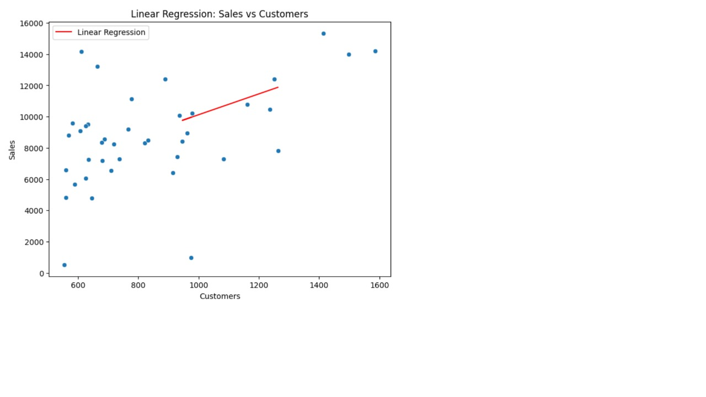

Slide 26
Thanks!
Please keep this slide for attribution

